Slide 1
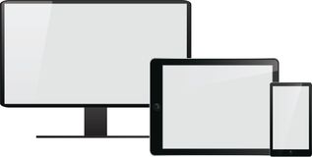

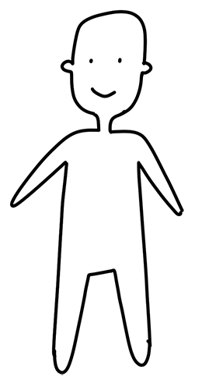
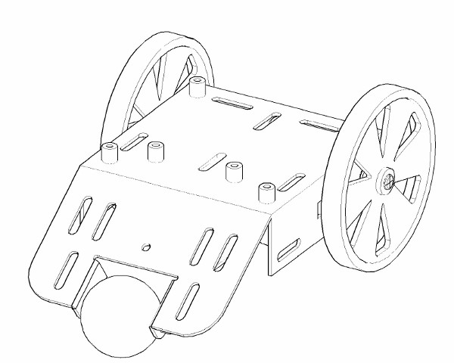
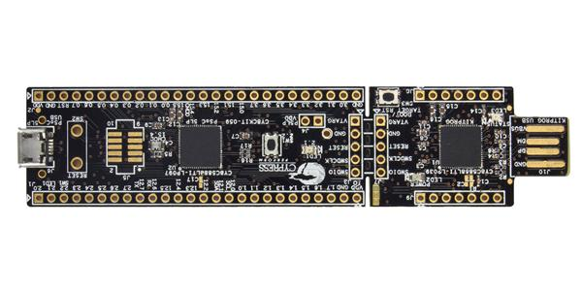



Semesterprojekt 4 - iFollow
Interface
Web – Server (Wi-Fi)
Wi-Fi
RPi
Interacts
with
Communicating With
Follow
Microcontroller
User
Controlled by
Using
Controlling
Using
Robot
GPS
Motor
Sensor

